Slide 1

ML22/23 Scalar Encoder with Buckets
Team_SpiralGanglions
Sahith Kumar Singari -1446809
Anil Kumar Gadiraju-1428607
Vinay Kumar Bandaru - 1447125

Slide 2
OBJECTIVE
The objective of the paper is to evaluate the limitations of Scalar Encoder and propose a solution by combining it with Buckets to improve its versatility and adaptability to varied datasets. The paper aims to address the challenge of converting continuous quantities into discrete values, which is often required in machine learning and data analysis.
By introducing the concept of Buckets, the paper seeks to provide a more precise and efficient method for encoding data, particularly in scenarios where periodic encoding of values is needed. Overall, the objective of the paper is to enhance the performance and accuracy of Scalar Encoder in real-world applications, particularly in sensor data analysis.

Slide 3

TABLE OF CONTENTS
Introduction
Methodology
Implementation Buckets
Testcases
Results
Conclusion

Slide 4

INTRODUCTION
Scalar encoder with buckets is a method of transforming continuous data into discrete values that can be utilized for analysis, modeling, and machine learning. It entails segmenting continuous values into intervals or "buckets" and assigning them to the appropriate buckets.
Scientists study the cortex to understand sequence learning, and models based on neural readings are used to recognize sequences. However, these models may not work in real-world situations. Hierarchical Temporal Memory (HTM) is a biomimetic model based on the neocortex's features, which has shown promise in pattern recognition and learning the sequences and flow of sensory inputs.

Slide 5
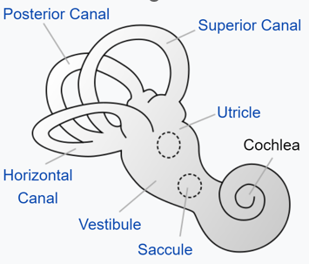
The encoding mechanism in HTM is comparable to how human and animal sensory organs work.
A system that transforms environmental noises into a sparse group of active neurons is the cochlea. In HTM's language, Sparse Distributed Representations (SDRs) are employed, with a fixed number of active bits that carry semantic significance.
In SDR, which is critical in HTM learning, two inputs with comparable semantic meaning must have equal active bit representation.HTM is built on the concept of SDRs, which are high-dimensional binary vectors with only a tiny percentage of their bits set to 1.
Fig 1:Innerparts of the ear.

Slide 6
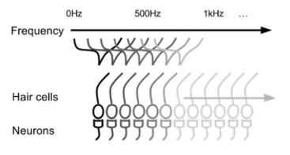
Because they allow for the efficient storing and processing of vast volumes of information, SDRs are a natural way for the brain to represent patterns.
To use HTM, data must first be transformed into an SDR using an encoder that captures the data's significant semantic properties.
The HTM model is based on how one layer of the brain functions and is designed to learn from continuous streams of input patterns to create sparse and stable representations of input sequences.
One of the key capabilities of HTM is its ability to predict future patterns based on previously learned patterns. The input patterns must be unique and not repeat to ensure the accuracy of the predictions.
Fig.2: Cochlear hair cells excite a group of neurons based on the frequency of the sound.

Slide 7
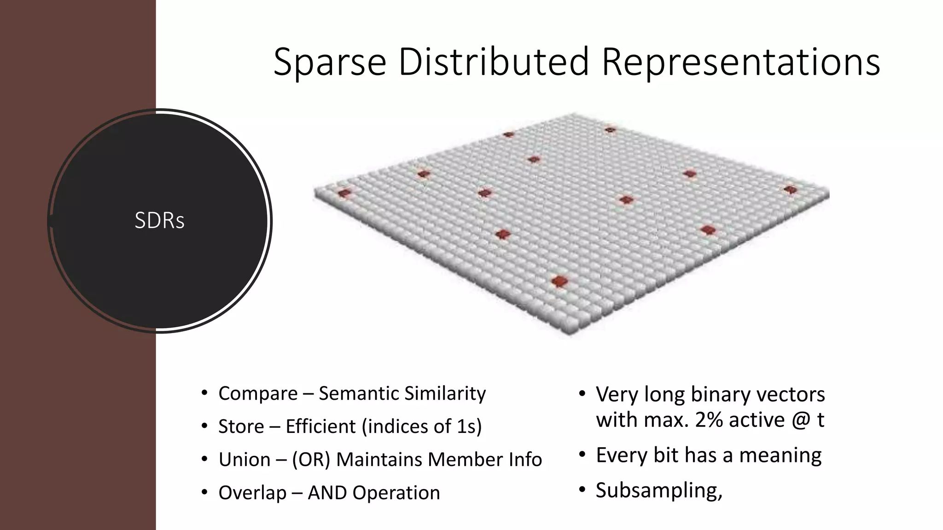
Methodology
Spatial Pooler maps active columns' cells during SDR input creation.
Implementing inhibitory mechanism results in constrained representation of input with similar patterns resulting in similar activation columns.
Learning occurs through synapse persistence updates, with active bits enhancing persistence and inactive columns being boosted to ensure participation in training.
SDR is a sparse information organization system, meaning only a small fraction of the cells are active at any given time.
Fig3:SDR Diagram contains Active columns

Slide 8
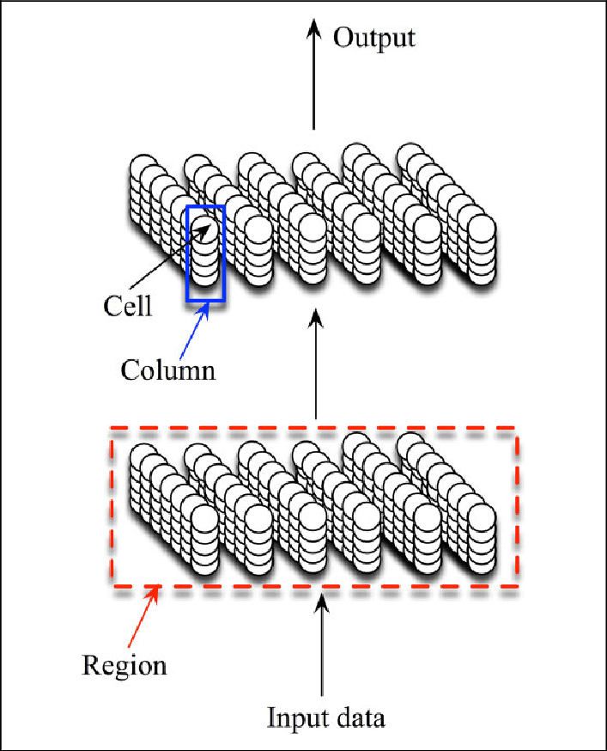
Active cells in SDR are distributed throughout the region to represent the region's activity.
The binary representation of SDR in HTM is highly computationally efficient and does not result in a functional loss of information due to critical features of SDR.
Buckets are used to divide a continuous value range into consistently sized intervals.
The width of each bucket is calculated by dividing the range of values by the number of buckets needed.
Fixed-width bucketing is a basic and extensively used scalar encoding technique, although it may not be suitable for data with irregular distribution.
Fig5:A Section Of HTM Region

Slide 9
Implementation
Understand the components of your data to design an effective encoder.
Divide the value range into buckets and map them to active cells to build the encoder implementation.
A scalar encoder is a device that converts a numeric (floating point) value to a bit array. The output is entirely 0's with the exception of a continuous block of 1's whose placement changes in real time as the input value changes.
Linear encoding is employed, although nonlinear encoding is possible by modifying the scalar before encoding (e.g., with a logarithm function).Binding the data as a pre-processing step is not recommended because it loses information and prevents neighboring values in the result from overlapping. A

Slide 10
GetFirstOnBit: Returns the bit offset of the first bit to be set in the encoder output. GenerateRangeDescription: Creates a description from a range's text description. GetBucketIndex: Subclasses must override this method and return a list of values for every bucket that the encoder has specified. GetBucketValue: Sets the value of the bucket at the given index to the given value. GetBucketInfo: Returns information about the associated bucket in the scalar encoder as an int array that is generated by passing a double input value. EncodeIntoArray: Encodes input data and writes the encoded value to a 1-D array of length. GetEncodedValues: Returns the input data in the same format as the "topDownCompute" method, which is the same as the input data for most encoder types. ClosenessScores: Calculates ratings of proximity between the expected and actual scalar values, providing a single closeness score for each value in expValues (or actValues).

Slide 11
These are unit tests for different methods of the Scalar Encoder class, including GetBucketIndex, GenerateRangeDescription, ClosenessScores, EncodeIntoArray, Decode, and _getTopDownMapping, which verify the functionality and accuracy of the methods for encoding and decoding scalar values, generating range descriptions, calculating closeness scores, and mapping input values to encoder buckets.

Slide 12
Result
From all the testcases carried out in the training phase Increased Precision: The Scalar Encoder with Buckets maps input values to continuous ranges of buckets rather than individual buckets, providing for greater data encoding precision.
Improved Flexibility: It automatically determines parameters like the number of buckets and bucket size based on the input data, making it more adaptable to varied datasets.
Scalar Encoder with Buckets provides periodic encoding of values, which allows for better handling of cyclical data.
Overall, the Scalar Encoder with Buckets encodes continuous data in a more flexible and accurate manner, making it a superior choice for many practical uses.

Slide 13
CONCLUSION
The Scalar Encoder with Buckets is an effective method for encoding continuous data into a sparse distributed representation suitable for use in HTM systems. It overcomes the limitations of the Scalar Encoder by utilizing testcases to transform continuous input values into a definite number of buckets, resulting in high precision while encoding data. Its successful implementation suggests its potential for application in a variety of domains, including anomaly detection, prediction, and classification. The test cases performed indicate that the Scalar Encoder with Buckets is functioning as expected and accurately encodes and decodes scalar values.

Slide 14
References
[1] | S. &. H. .. Ahmad, “ “Properties of sparse distributed representations and their application to hierarchical temporal memory.,”,” 2011. [Online]. Available: doi: 10.1371/journal.pone.0022149.
[2] | S. A. J. Hawkins, ““Why neurons have thousands of synapses, a theory of sequence memory in neocortex,”,” 2016. [Online]. Available: https://www.frontiersin.org/articles/10.3389/fncir.2016.00023/full.
[3] | S. Purdy, “Encoding Data for HTM Systems,” [Online]. Available: https://arxiv.org/ftp/arxiv/papers/1602/1602.05925.pdf.
[4] | “Scalar Encoders,” [Online]. Available: https://arxiv.org/ftp/arxiv/papers/1602/1602.05925.pdf.
[5] | S. P. S. Ahmad, “Spatial Pooling with Hierarchical Temporal Memory,” [Online]. Available: https://arxiv.org/abs/1705.05363.

Slide 15
Thank You Team_SpiralGanglion

